Slide 1

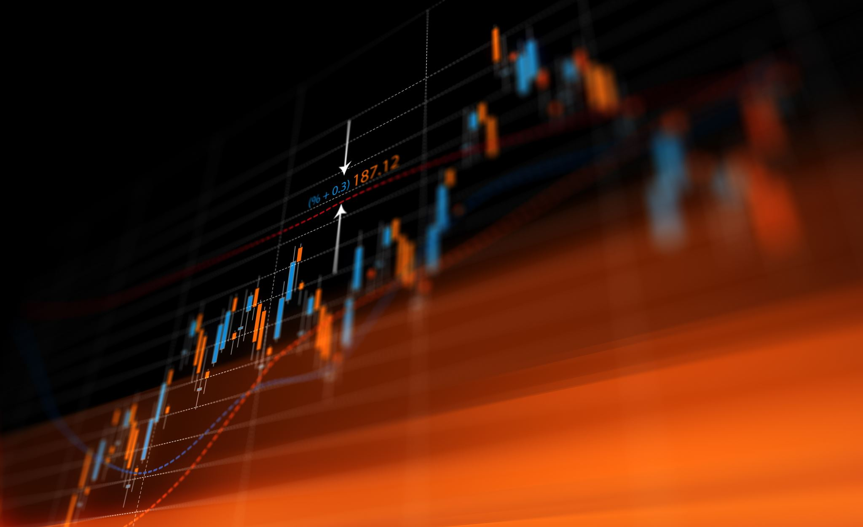

Crypto Time Series Analysis and Prediction
Aiswarya Kale
Naga Sireesha Chinthala
Data 690: Financial Data Science
Prof Abdullah Karasan

Slide 2
Introduction
While the world was (and still is) in the grip of a pandemic in 2020, crypto’s have had a stellar run. Especially, Bitcoin From its spectacular crash in 2018 and a relatively uneventful year in 2019, it started 2020 with a price of USD$8,000 to an all-new record high of USD$65,000. That’s roughly more than an 800% return! It is one of the most successful investments of 2020.
Ethereum and Ethereum classic also followed similar patterns during the pandemic.
We will analyze trends of three popular crypto’s Bitcoin, Ethereum, and Ethereum classic.
We will predict the trend and price using the time series ARIMA model and RNN model LSTM.
The data has been downloaded from yfinance API for all the three crypto’s and closing price is considered throughout the analysis.

Slide 3
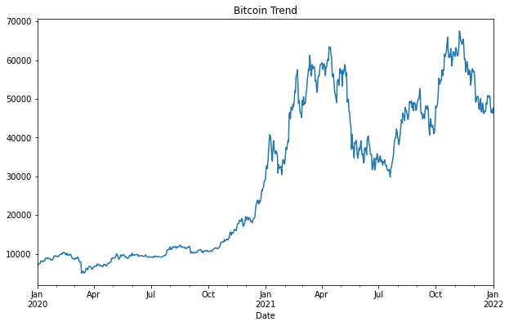
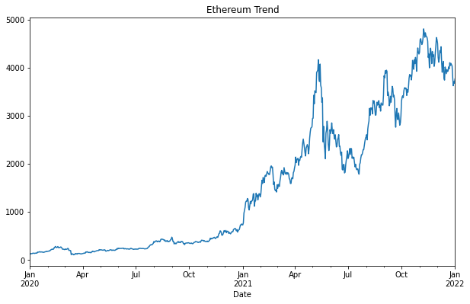
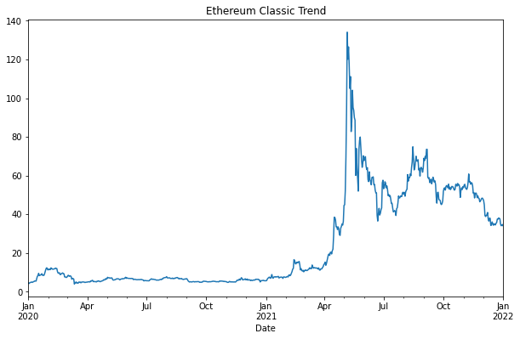
Exploratory Data Analysis
Bitcoin and Ethereum have an upward trend. Ethereum Classic also has a slight upward trend, but there was a sudden spike and drop in April 2021.
Data does not look stationary from the trend.

Slide 4
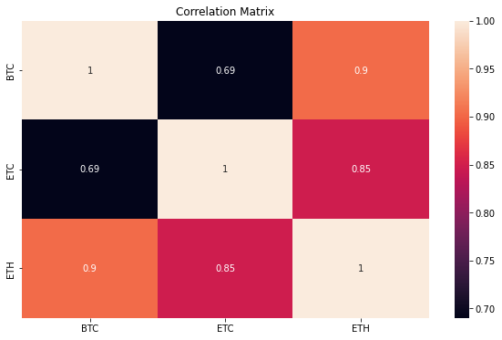
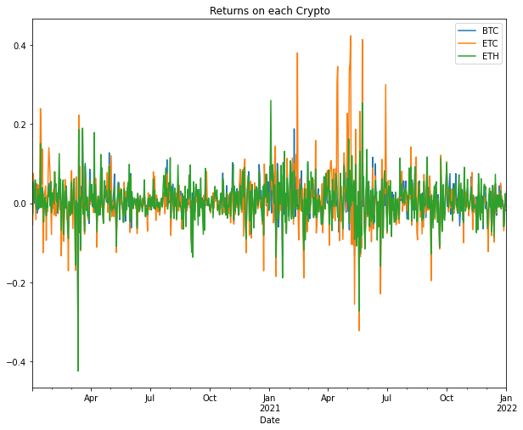
Exploratory Data Analysis (Cont..)
All three cryptos has a very high positive correlation. Bitcoin and Ethereum are very highly correlated.
Returns on each of these cryptos followed similar patterns and almost overlapping.

Slide 5
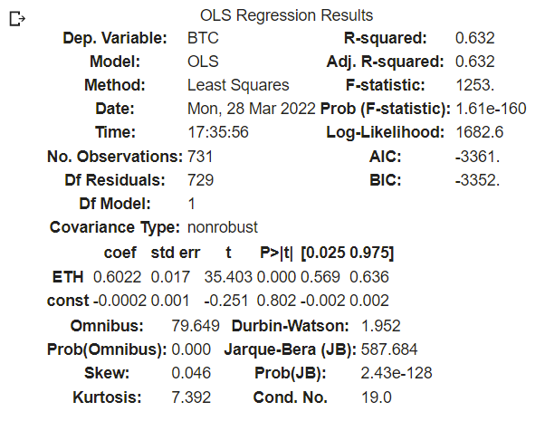
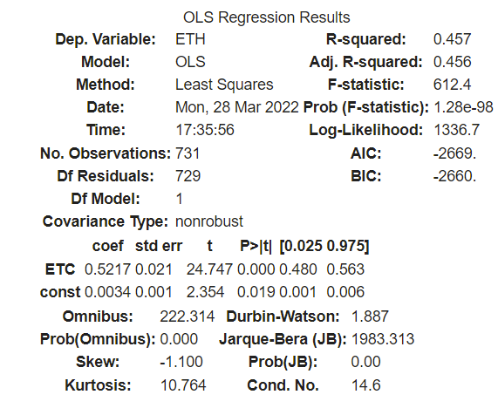
Exploratory Data Analysis (Cont..)
To understand the correlation between these cryptos we have used the OLS stats model. The model results suggest that the changes in one crypto are considerably impacting the other.
Based on the model results, Ethereum explains 63% of the variance in Bitcoin price changes and Ethereum Classic explains 46% of the variance in Ethereum price.
We can say that these three cryptos are highly cointegrated.

Slide 6
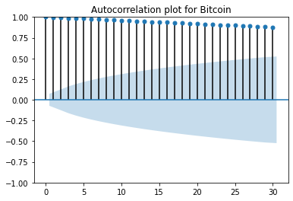
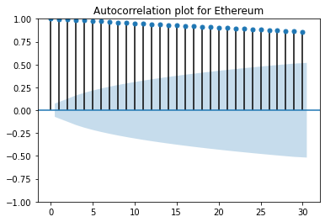
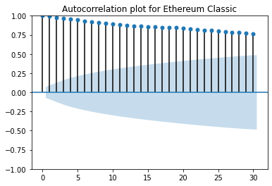
Stationarity Check
Initial analysis suggests that the data is not stationary. We have used Auto-Correlation, Partial Auto-Correlation, and Augmented Dickey-Fuller test (ADF) to check the stationarity. Results of all three tests confirm that the data is not stationary.
The p-value of ADF test for BTC 0.073 | The p-value of ADF test for ETH 0.91 | The p-value of ADF test for ETC 0.38

Slide 7
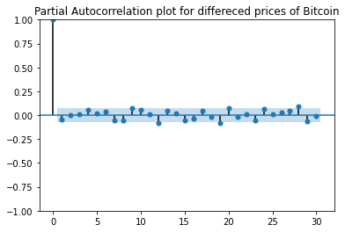
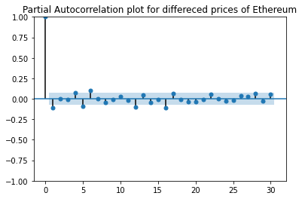
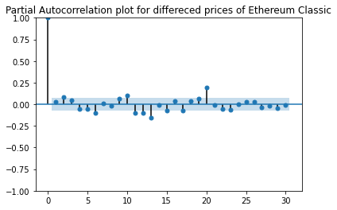
Stationarity Check
To make the data stationary, we took the differenced prices of stocks.
And we again verified the stationarity on differenced data using Auto-Correlation, Partial Auto-Correlation, and Augmented Dickey-Fuller test (ADF). Results of all three tests confirm that the differenced data is stationary.
The p-value of ADF test for BTC 0.0 | The p-value of ADF test for ETH 0.0 | The p-value of ADF test for ETC 0.0

Slide 8
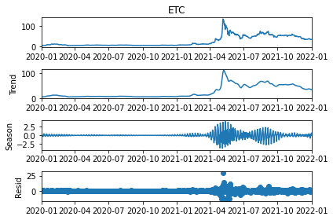
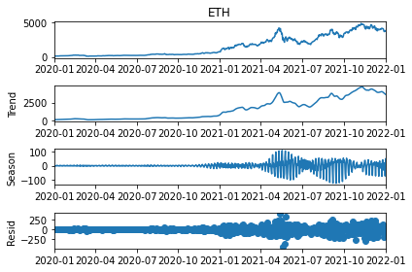
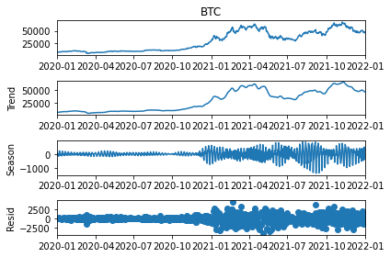
Seasonality Check
There is no seasonal behavior observed in any crypto prices.

Slide 9
Prediction Using ARIMA
ARIMA (Autoregressive Integrated Moving Average Model) takes 3 parameters
p: The number of lag observations included in the model also called the lag order.
d: The number of times that the raw observations are differenced, also called the degree of difference.
q: The size of the moving average window, also called the order of moving average.
These parameters are selected based on low AIC values.
The model has been run for all the three cryptos and forecasted values for out of sample data.

Slide 10
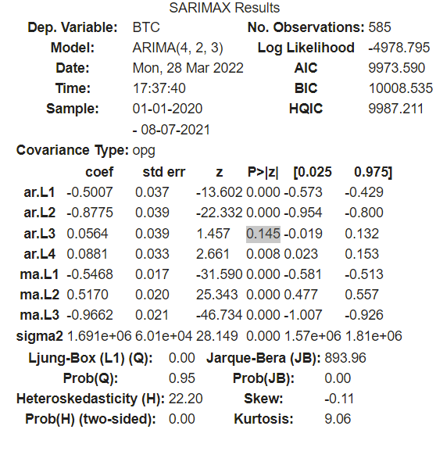
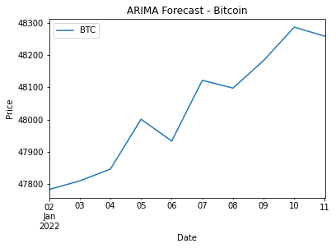
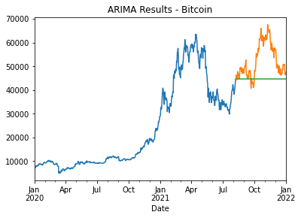
ARIMA Results - Bitcoin
Parameters based on low AIC are : p = 4, d = 2, q = 3
Based on p-values except for auto regressor lag 3, all the remaining lag coefficients are statistically significant.
The out-of-sample forecast showed an upward trend, meaning it is a good idea to invest in Bitcoin.

Slide 11
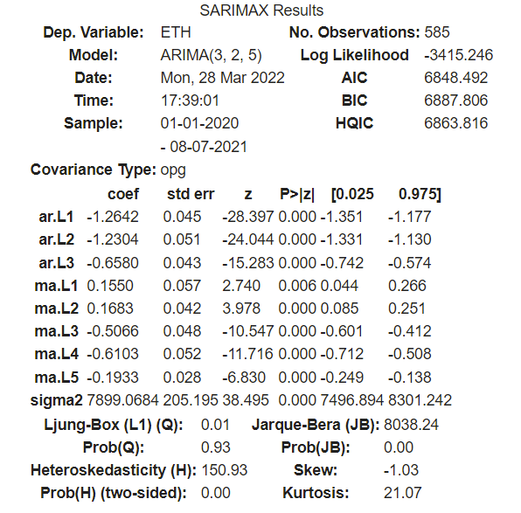
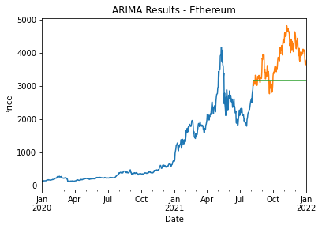
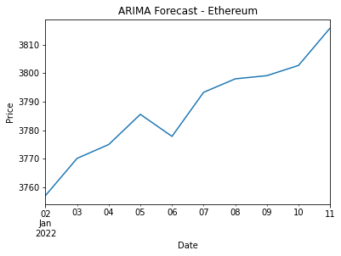
ARIMA Results - Ethereum
Parameters: p = 3, d = 2, q = 5
All the lag coefficients are statistically significant
Ethereum also showed upward trend for out of sample forecast.

Slide 12
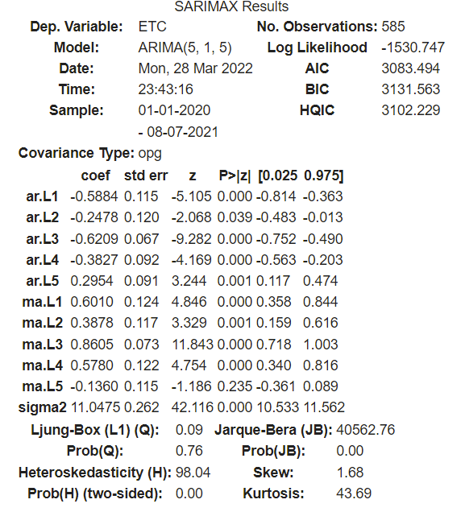
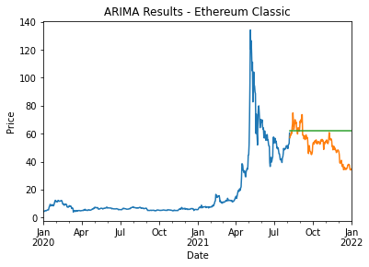
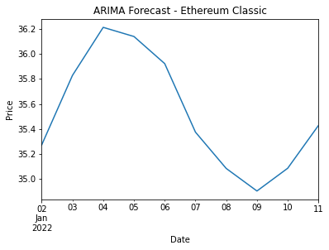
ARIMA Results – Ethereum Classic
Parameters: p = 5, d = 1, q = 5
Except for the moving average lag 5, all other coefficients are statistically significant
Ethereum Classic has shown a downward trend for out-of-sample forecast.

Slide 13

Prediction Using LSTM
LSTM performs very well for sequential data such as time series. RNNs are able to form a much deeper understanding of a sequence and its context compared to other algorithms.
In an RNN, the information goes through a cycle. When making a decision, it considers the current input and also what it has learned from the inputs it has received previously.
In an LSTM you have three gates: input, forget and output gate. These gates determine whether or not to let new input in (input gate), delete the information because it isn’t important (forget gate), or let it impact the output at the current timestep (output gate).
Data is divided into 80% training and 20% testing.

Slide 14
Methodology
DATA PREPARATION
Standardization
Data Split into 80% and 20%
04
Univariate Prediction of the expected close value of cryptocurrency
01
03
Building the model
-LSTM with 50 neurons 2 Dense Layers
Training the model
Past 60 day’s close value of cryptocurrency
02

Slide 15
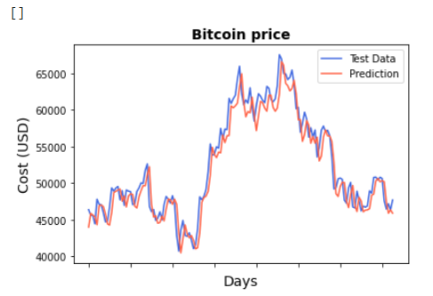
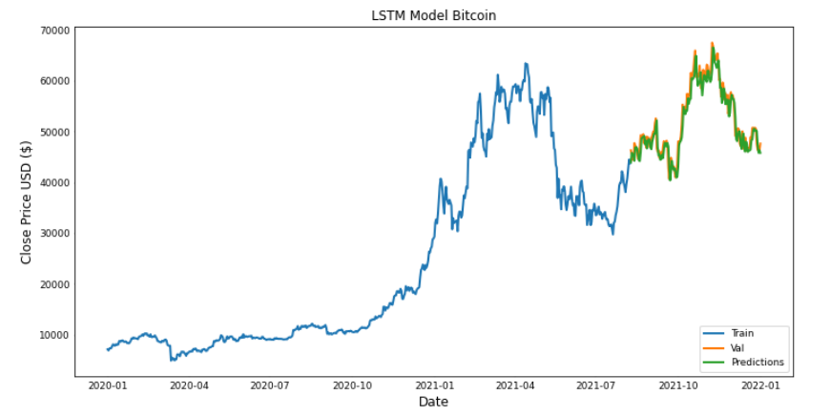

LSTM Results – Bitcoin
RMSE: 1944.0829271354098
MAE: 1516.2626016695206
R2 score: 0.9198929474919921

Slide 16
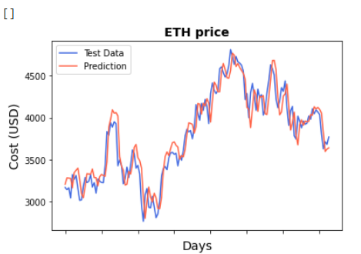
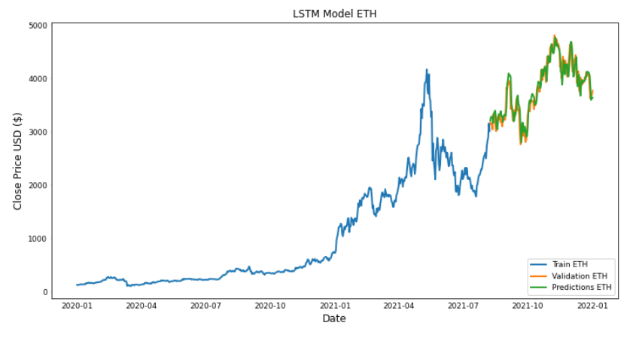
LSTM Results – Ethereum
RMSE: 171.84604520273467
MAE: 140.30372097067635
R2 score: 0.8890275882520761

Slide 17

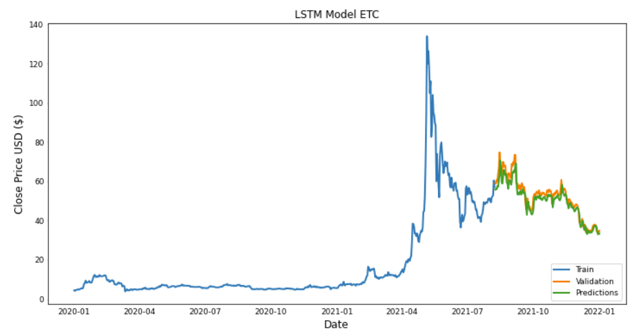
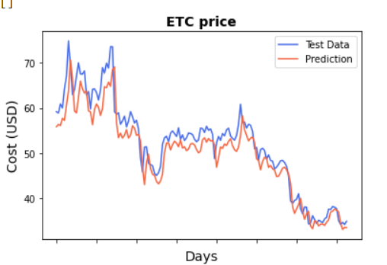

LSTM Results – Ethereum Classic

Slide 18
Conclusion
All the cryptos are highly cointegrated.
Both models performed certainly well.
ARIMA has done well in predicting the trend, though not the actual price. LSTM has done a good job in predicting the price closer to actual prices.
Bitcoin and Ethereum showed an upward trend for forecasted data, meaning it is a good idea to invest in them.
Ethereum Classic has not shown a certain upward trend.

Slide 19

References
https://machinelearningmastery.com/arima-for-time-series-forecasting-with-python/
https://www.machinelearningplus.com/time-series/arima-model-time-series-forecasting-python/
https://www.analyticsvidhya.com/blog/2017/12/fundamentals-of-deep-learning-introduction-to-lstm/
https://medium.com/analytics-vidhya/time-series-analysis-of-cryptocurrencies-using-deep-learning-fbprophet-48abdb2e7ebf
https://machinelearningmastery.com/time-series-prediction-lstm-recurrent-neural-networks-python-keras/

Slide 20

Queries..?

Slide 21

THANK YOU

